Slide 1
Narrative Explanation Generation
Jeeva Saravana Bhavanandam
12/02/24

Slide 2
Task 4: Narrative Explanation Generation
Introduction
Task: Generate narratives with contextual explanations from datasets.
Relevant Domains: Literary analysis, historical document analysis, thematic exploration.
Challenges: Semantic understanding + contextual relevance.
Objective
Build a hybrid retrieval system:
- Combine semantic embeddings and knowledge graphs.
Key goals:
- Vector-based retrieval for semantic similarity.
- Knowledge graph construction for relational insights.
- Hybrid integration for better narrative retrieval.

Slide 3
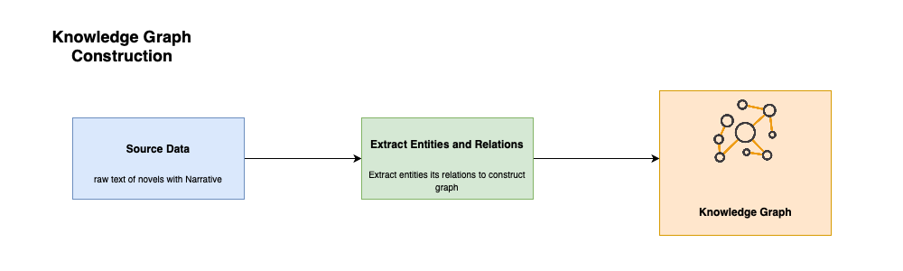
Knowledge Graph
Graph Schema Design
The schema of the knowledge graph was designed to represent key entities and relationships:
- Entities:
- Author: Represents the creator of literary works.
- Book: Represents a specific work of an author.
- Narrative: Captures thematic or event-driven descriptions.
- Explanation: Provides contextual insights for each narrative.
- Relationships:
- Author → WROTE → Book
- Book → HAS → Narrative
- Narrative → HAS → Explanation
Knowledge Graph Construction
- Parsed each row of the dataset.
- Created nodes for unique authors, books, narratives, and explanations.
- Established relationships based on the schema.
Graph-Based Retrieval
- Handles structured queries (e.g., narratives by authors, keyword-linked explanations).
- Neo4j: Efficient traversal of relationships for contextual relevance.

Slide 4
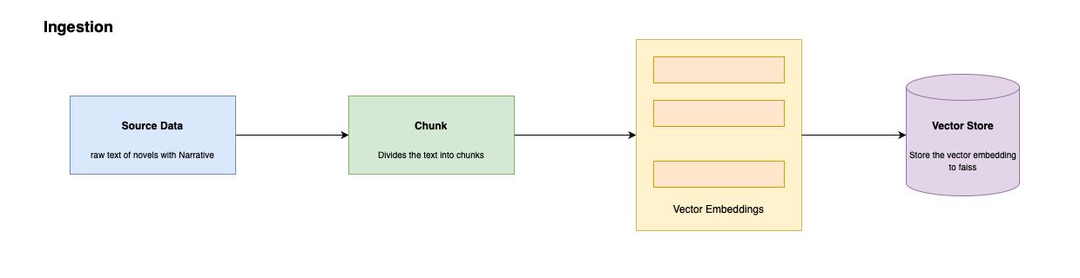
Vector Based Retrieval
Vector Based Retrieval
Tool: FAISS (Facebook AI Similarity Search) for efficient vector storage and retrieval.
Goals:
- Finds semantic similarity in high-dimensional space.
- Captures thematic and subtle textual nuances missed by graphs.
Steps:
- Compute embeddings for all dataset narratives.
- Initialize FAISS IndexFlatL2 (L2 distance for similarity).
- Add embeddings to the FAISS index for retrieval.
Benefit: Fast and accurate similarity search for narrative embeddings.

Slide 5
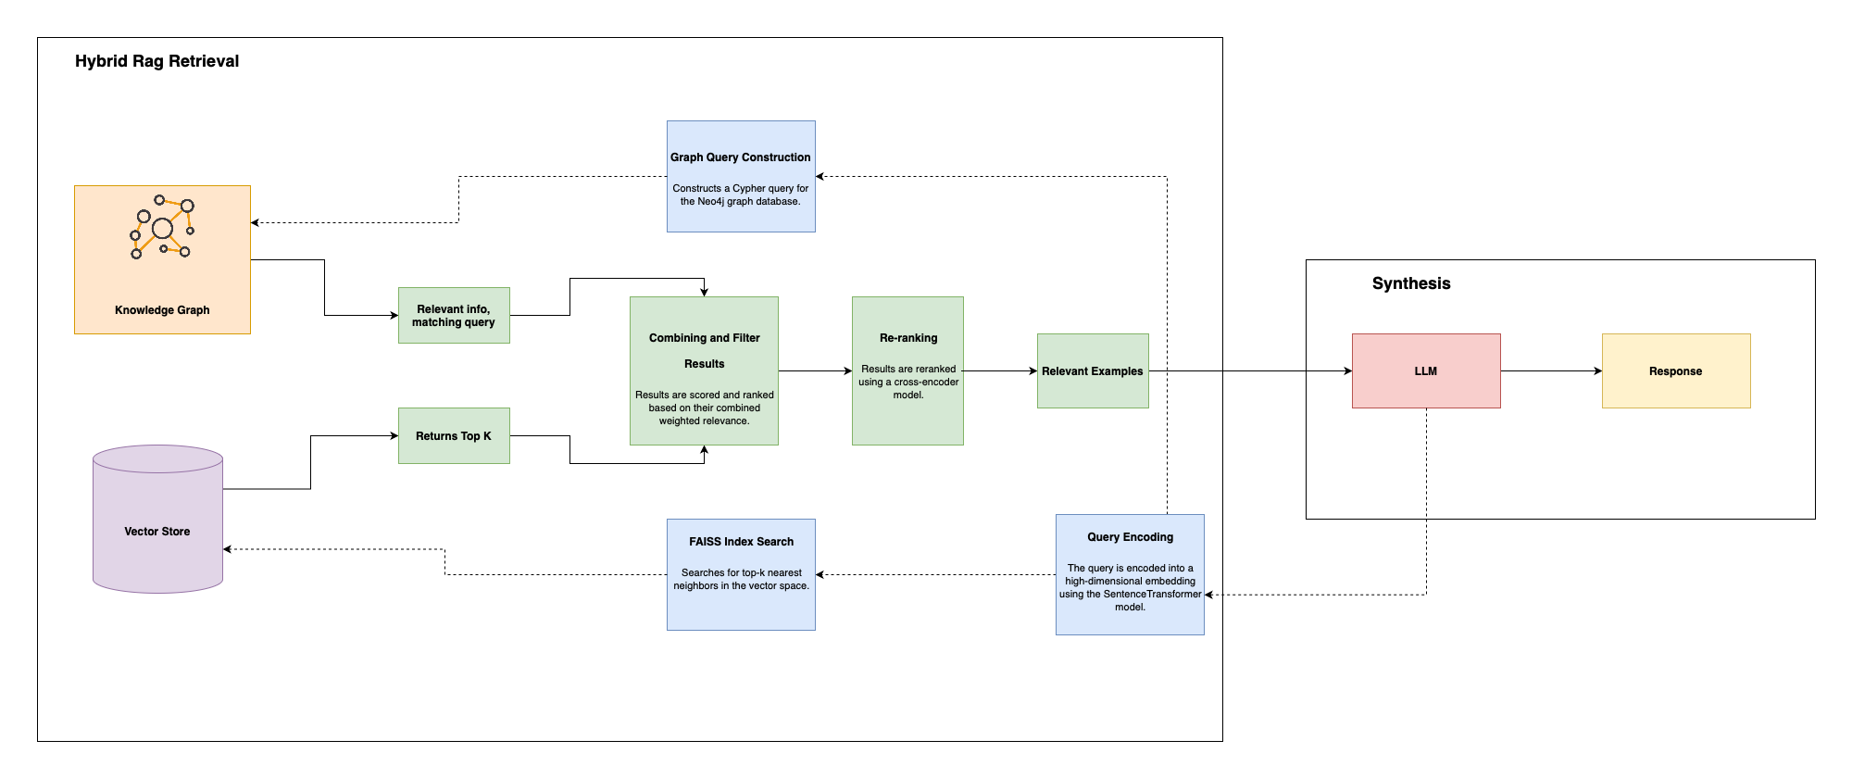
Hybrid Retrieval with Graph and Vector Store
Hybrid Approach
- Graph Querying: Retrieves narratives via explicit relational criteria.
- Vector Querying: Retrieves top-k semantically similar narratives using FAISS.
- Result Combination:
Scoring formula: Score = (Graph Weight × Graph Score) + (Vector Weight × Vector Score).
Reranking
- Purpose: Refine retrieved results for better accuracy.
- Model Used: Cross-encoder/ms-marco-MiniLM-L-6-v2.
- Process:
- Input: Query + retrieved narrative pairs.
- Compute: Relevance score for contextual fit.
- Sort: Results based on relevance scores.
Outcome
- Combines relational precision and semantic richness.
- Enhances retrieval accuracy and contextual relevance

Slide 6
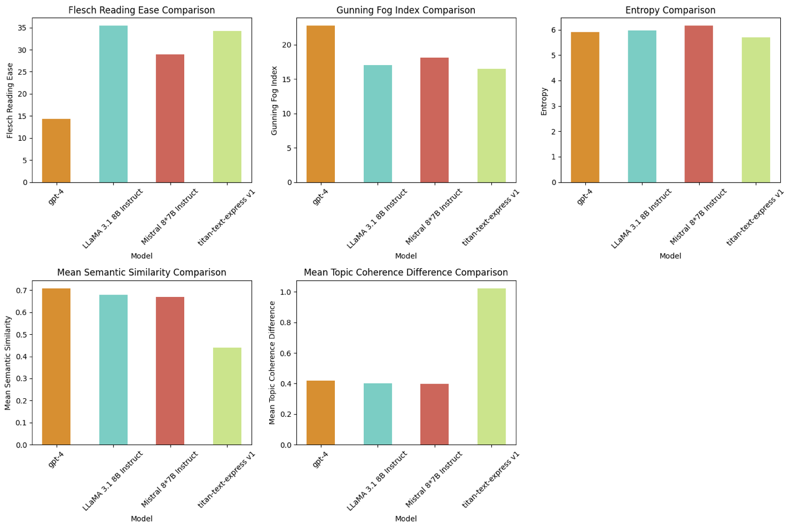
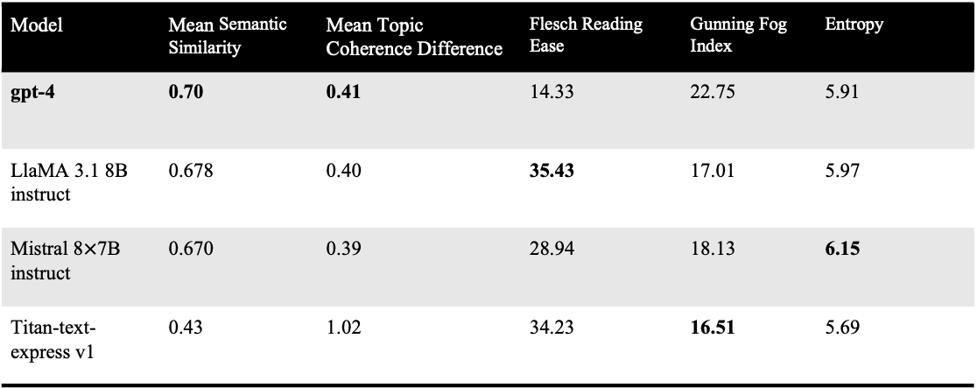
Performance
Model | Mean Semantic Similarity | Mean Topic Coherence Difference | Flesch Reading Ease | Gunning Fog Index | Entropy
gpt-4 | 0.70 | 0.41 | 14.33 | 22.75 | 5.91
LlaMA 3.1 8B instruct | 0.678 | 0.40 | 35.43 | 17.01 | 5.97
Mistral 8$×$7B instruct | 0.670 | 0.39 | 28.94 | 18.13 | 6.15
Titan-text-express v1 | 0.43 | 1.02 | 34.23 | 16.51 | 5.69
GPT-4
- Semantic Similarity: Highest (0.70).
- Topic Coherence: Best alignment (0.41).
- Readability: Low (Flesch 14.33, Fog 22.75).
LLaMA 3.1 8B Instruct
- Semantic Similarity: Moderate (0.678).
- Readability: High (Flesch 35.43, Fog 17.01).
Mistral 8×7B Instruct
- Coherence: Balanced (0.39).
- Semantic Similarity: Moderate (0.670).
- Readability: Medium (Flesch 28.94, Fog 18.13).
Titan-text-express v1
- Simplicity: Lowest entropy (5.69).
- Semantic Similarity: Lowest (0.43).
- Coherence: Weak (1.02).

